Slide 1



GSX.ORG

Slide 2


Red Teaming as an ESRM Catalyst:
Preparing for Unpredictable Threats
Ana Aslanishvili & Shawn Abelson
GSX.ORG
GSX.ORG

Slide 3

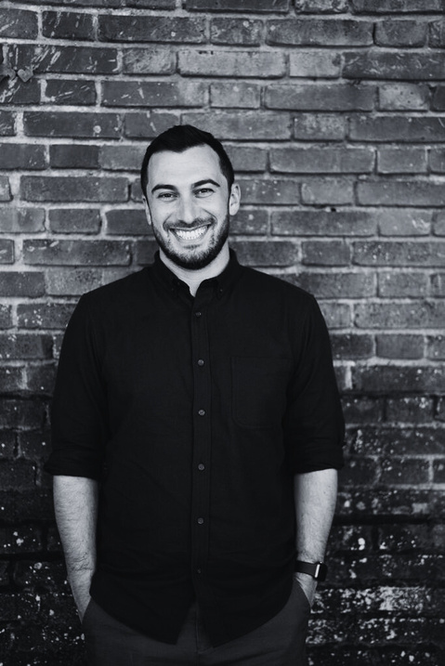








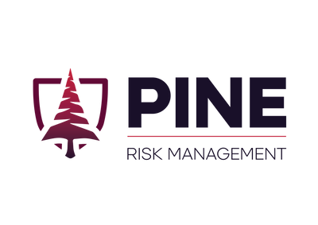

About Us
PRM: We conduct, build, and train red teams, helping organizations mature and improve security.
Meta: Started largest physical red team in Silicon Valley, hired dozens of testers, and built a team to oversee findings remediation across global office and data center footprint.
Ana
Shawn
Wells Fargo
Security Technologies
M.S.
Meta
Security
Consulting
Meta
Red Team Tools
The CORE Group
U.S. Bank
Center for Advanced Red Teaming
Graduate Faculty
Red Teaming
PRM
PRM
HCSO
GSX.ORG
Notes:
STREET CREDS:
Early in my career I’ve had cops pull AR15s on me, police helicopters called, and I’ve shut down mass transit line before. I am one of the most cautious red teamers you will meet. My focus is on de-risking red teaming. That doesn’t mean it’s boring or ineffective. You can still be bold. You can be bold and dumb, or bold and smart. OUR GOAL IS TO HELP YOU BE BOLD AND SMART, and to mature the profession of physical red teaming. It's often considered sub-part of cybersecurity but there's a small number of us who have made a fulltime profession out of focusing on it. It's on those of us that do it full time to help the profession grow and mature, and to encourage and support our sister teams on the cyber side to join us and do more physical testing.
TEST THE UNTESTABLE:
We’ve spent the last couple years testing everything from supply chain to event security, explosives detection and mail screening to executive protection - and we’ve gotten good at testing the untestable.
There IS NO MARGIN TO MISS IN PHYSICAL SECURITY. A miss means something explodes, someone gets hurt or killed, or an attacker gains full access and persistence via a server room, or is able to bug the boardroom or exfil your most important trade secrets. The consequences of one successful physical breach can be catastrophic.
So - let's go through how we can test and improve physical security, and ensure that we find vulnerabilities before adversaries do.
DISCLAIMER: Stories are real but may be changed or combined in a way to prevent any customer information coming out. We often hold company’s biggest vulnerabilities in our hands and can never even come close to the line of revealing their sensitive info.

Slide 4







What is Red Teaming?
STRESS TESTING: TESTING THE SYSTEM WITH THE GOAL TO IMPROVE IT.
The Red Team is the Blue Team in disguise.
GAINING THE ADVANTAGE
Sparring partner
Medical check-up
Fire drill
Test drive
Scrimmage
Controlled experiment
GSX.ORG

Slide 5

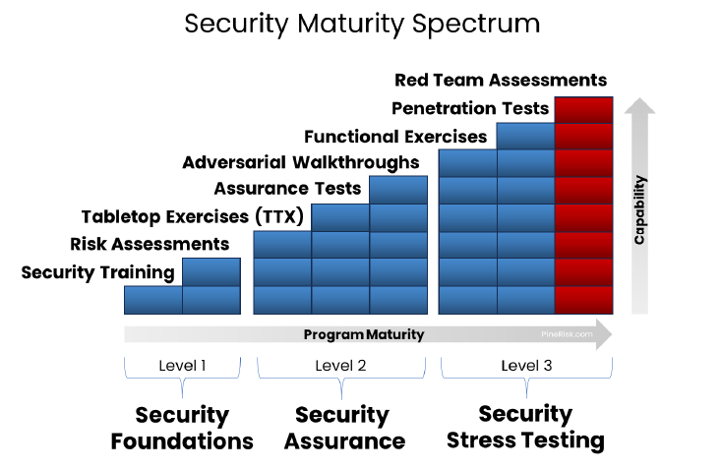


GSX.ORG

Slide 6
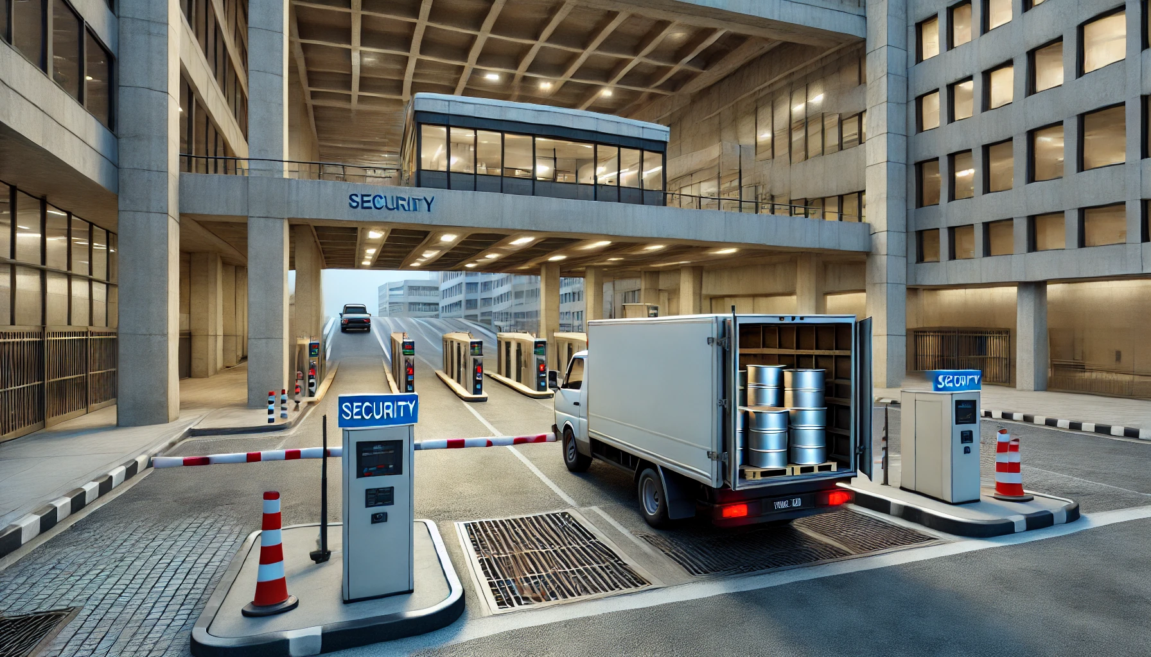
Case Study
VBIED
Airpod Thefts,
Root Causes,
New Policies &
Saved Budgets
GSX.ORG

Slide 7

Identify
Risks
Continuous
Improvement
ESRM & Red Teaming
BETTER DATA LEADS TO BETTER DECISIONS
Vulnerability
Management
Enterprise Assets
Partnership
Business
Risk
Owners
Shared
Mission
Red Teaming
ESRM
Risk
Based
Approach
Risk
Management
Holistic
Shared
Prioritize
Assets
Responsibilities
GSX.ORG
Notes:
Managing Risks with a Business-Focused Approach
--->
For the business to own the risk the business must understand the risk.
-->
Red Teaming identifies, explains, clarifies, and tests complex risks
-->
Demystify Complex Risks: Red teaming takes abstract risk scenarios and tests them in real-world experiments
-->
Leaders with specific evidence-based data can make informed decisions. Informed decisions are better decisions, and better decisions help the business meet it’s goals.
IF YOU WANT EFFECTIVE ESRM, YOU NEED TO RED TEAM. IF YOU WANT TO BE CONFIDENT IN YOUR SECURITY PROGRAM, AND IF YOU WANT YOUR LEADERS TO TRUST YOUR SECURITY WORKS, YOU NEED TO TEST IT.
Prevent: "WHY DIDN'T WE THINK OF THAT"
Prevent: "WHAT WOULD HAPPEN IF Y TARGETED US?"
Confidently Answer: "COULD THAT HAPPEN TO US?"
Confidently Answer: "HOW DO WE KNOW OUR SECURITY PROGRAM WORKS?"
Red teaming asks and answers the hardest questions. Questions that no one else has asked, and questions that your leadership may ask you.

Slide 8

Risk
Likelihood
Consequence
Impact
Likelihood of Occurring
Likelihood of Success
INTENT
PHYSICAL
FINANCIAL
OPERATIONAL
CAPABILITY
TECHNOLOGY
REGULATORY
REPUTATION
EXTENDED ENTERPRISE
DETERRENCE
HUMAN
STRATEGIC
TECHNOLOGY (CIA)
Threat Actor and TTP
Control Effectiveness
Criticality - Resilience
VULNERABILITY
RISK
Modeling Risk
THREAT
ASSET
GSX.ORG

Slide 9




Making Security Smarter
OWN RISK
UNDERSTAND RISK
CLARIFY
BETTER DECISIONS
Business Areas own Their Risk
To Own Risk, You Must Understand Risk
Real Data is Better than a Risk Matrix
Real-World Scenarios
Better Data
Uncover the most relevant risks
Video and Stories of Specific Risks
Demystify Complex Risks
Better Decisions
Partner with the business
Plus Examples of Impact to Business
Easier to Mitigate Specific Proven Risks
Better Business
Red Teams Inform Business Leaders
GSX.ORG

Slide 10
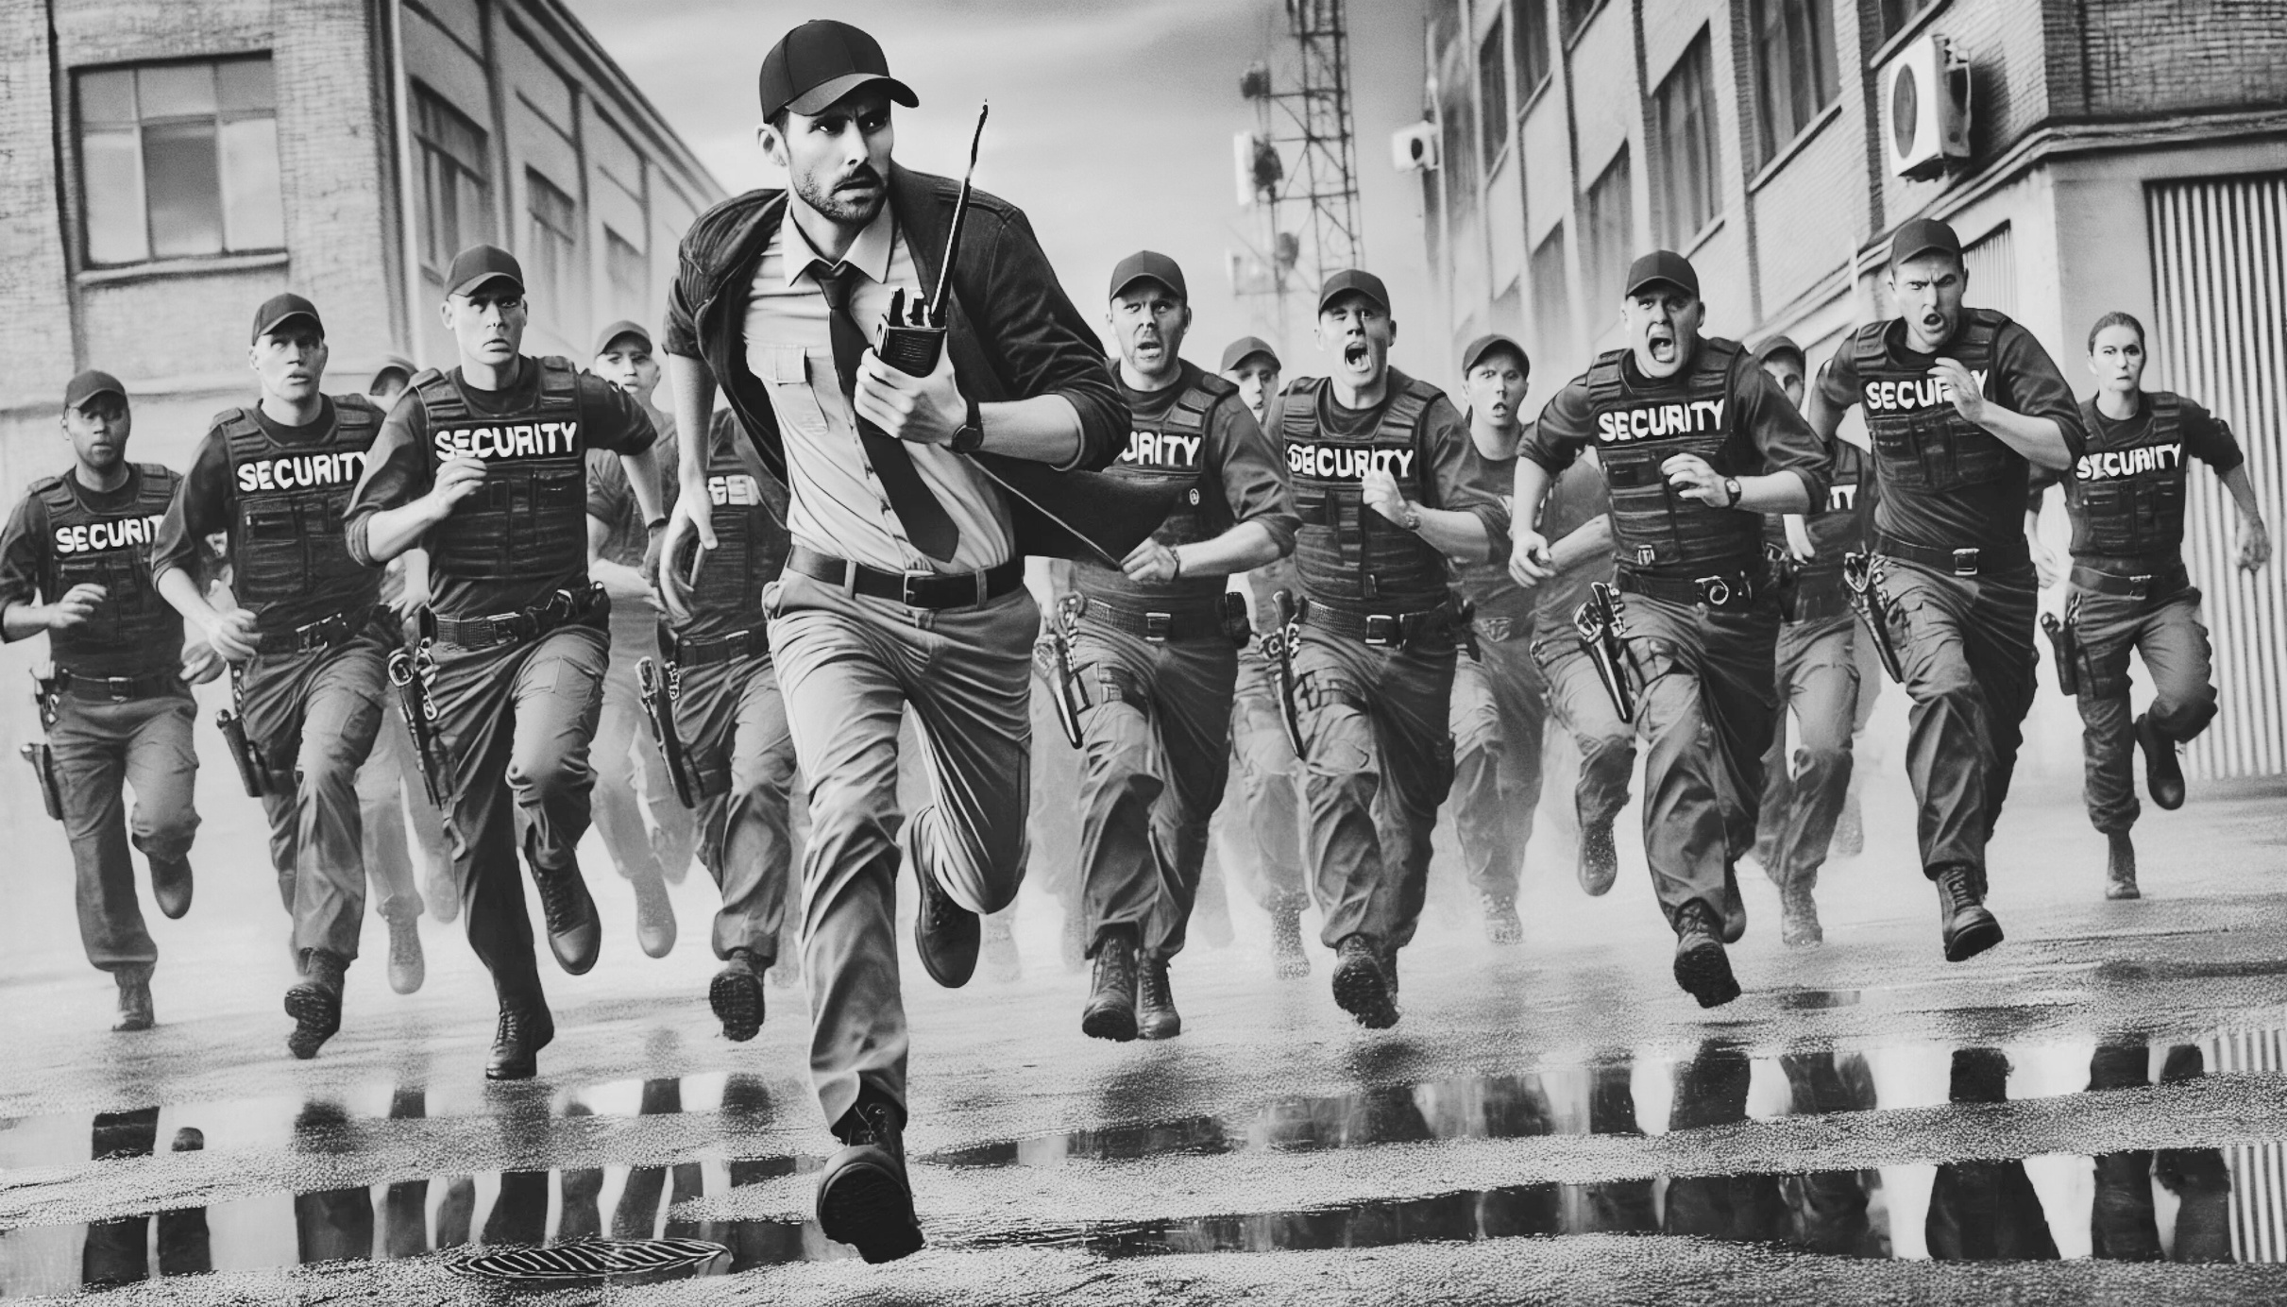
Case Study
15 v 1
Radio Thefts,
Bugs,
and Foot Chases,
Oh My
GSX.ORG

Slide 11










Physical Security
Protecting People, Assets, and Reputation.
Physical
Components of Physical Security
Physical: Doors, locks, gates, bollards, etc.
Human
PHYSICAL
SECURITY
Technology: PACS, CCTV, Radios, Investigative, and Intelligence tools
Technology
Human: Guards, Analysts, Managers, Awareness, Processes & Procedures
GSX.ORG
Notes:
We recognize the value that cyber brings to physical. We want testing to be a win for not just one team but both. Our goal is to make it easier for you to conduct tests that create actual change.

Slide 12

Case Study
Kidnap
Airpod Thefts,
Root Causes,
New Policies &
Saved Budgets
GSX.ORG

Slide 13








Security Objectives
Loss Avoidance
Deter
Detect
Prevent
Alert
Respond
Recover
Protect / Delay
GSX.ORG
Notes:
FAST SLIDE
Every physical security measure has one or more of these goals. Cameras help deter and respond/investigate. Very rarely they help with detect or alert.
Why does this matter? Because as a red teamer, if you want to test whether security prevents you from gaining access, when you get in, you leave, and then you’re done. If you want to assess prevention, detection, and response – then you get in a few times, and you escalate until you’re caught.

Slide 14
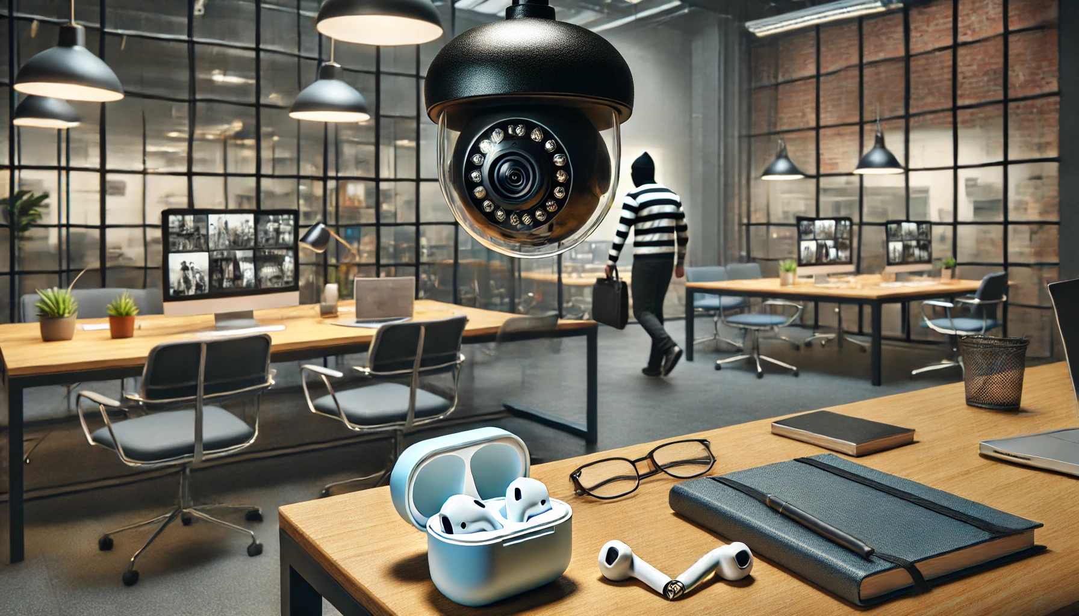
Case Study
CCTV
Airpod Thefts,
Root Causes,
New Policies &
Saved Budgets
GSX.ORG

Slide 15

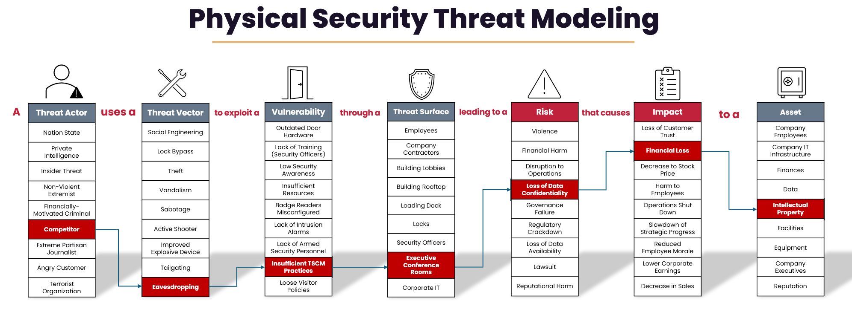
Physical Security
Threat Modeling
GSX.ORG

Slide 16



Creating Business Value
Test Efficacy of Completed Projects
Uncover Gaps in Vendor Implementation
Guard Training
Loss Avoidance
Increase & Showcase Protection of Assets
Insurance
Tangible & Tested
Risk Reduction
Removal of Ineffective
Technology
Resource
Prioritization
Hunting
HiPPOs
GSX.ORG

Slide 17



Thank You!
Get in Touch
Text/Call: (628) 777-7475
Signal: (952) 465-4769
Shawn@PineRisk.com
Ana@PineRisk.com
Reddit.com/r/PhysicalRedTeam
LinkedIn.com/Company/PineRisk
GSX.ORG

